Slide 1

NEXTHIKES IT SOLUTION
PROJECT-6
Pharmaceutical Sales Forecasting Across Multiple Retail Stores
Mr. Abish Chaurasia
17th August 2025

Slide 2
Project Overview
🎯 Goal
Predict daily sales for Rossmann stores up to 6 weeks ahead
Enable better planning and decision-making for store managers
Tools & Technologies
Python, Pandas, NumPy
Scikit-learn (Random Forest, Pipelines)
TensorFlow/Keras (LSTM models)
MLflow (Model tracking & inference)
Streamlit (Web app for predictions)
Key Tasks
Exploratory Data Analysis (EDA) – Understand customer behavior, trends, promotions, holidays
Machine Learning Modeling – Build robust models using Sklearn pipelines
Deep Learning (LSTM) – Forecast future sales with time series modeling
Model Deployment – Serve predictions via an interactive web app

Slide 3
Exploratory Data Analysis
Data Cleaning
Dataset shape: 22,970 rows × 21 features
Handled missing values and detected outliers
Encoded categorical features and normalized formats
Logging
Implemented Python’s logger library
Tracked all major steps: cleaning, transformation, and visualization
Ensured reproducibility and debugging support
EDA Objectives
Understand customer purchasing behavior
Investigate impact of promotions, holidays, and competitors
Identify trends, correlations, and seasonal patterns

Slide 4
Key Insights from EDA
📊 Promotions
Significant sales increase during promotional periods
Promos also attract higher footfall (customer count ↑)
📅 Holidays
Public holidays generally show lower sales
Exception: Christmas season drives higher sales, especially in December
🔗 Correlation
Strong positive correlation between Sales and Number of Customers
Indication: Customer traffic is a key driver of revenue
📆 Weekends
Lower average sales on weekends
Exception: Sales improve if promotions are active during weekends

Slide 5
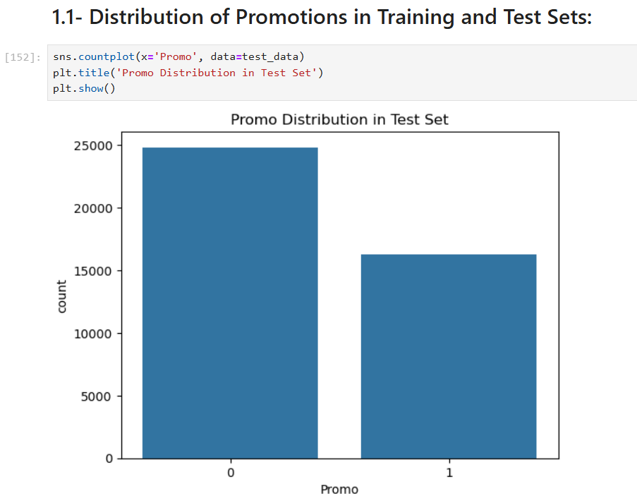
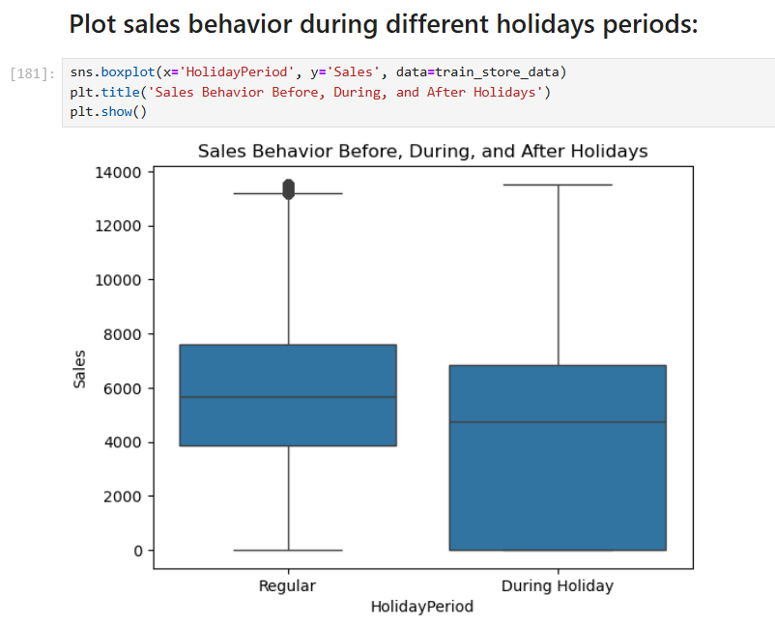
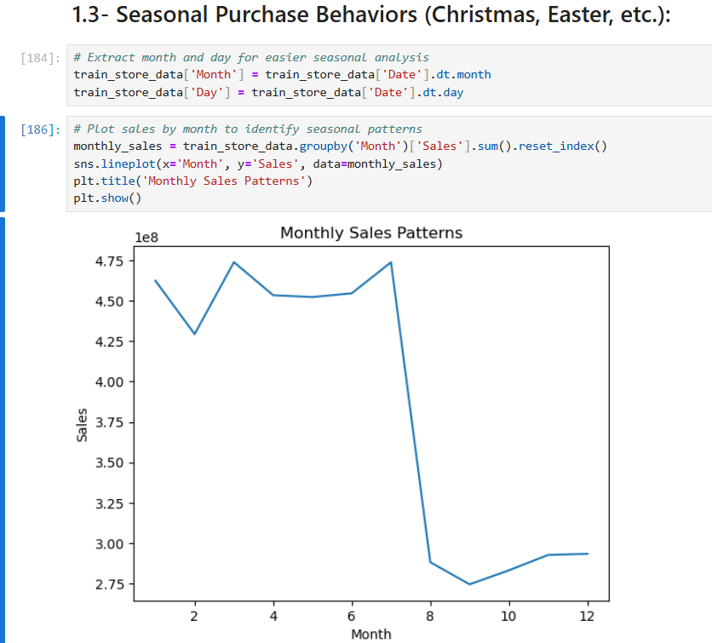
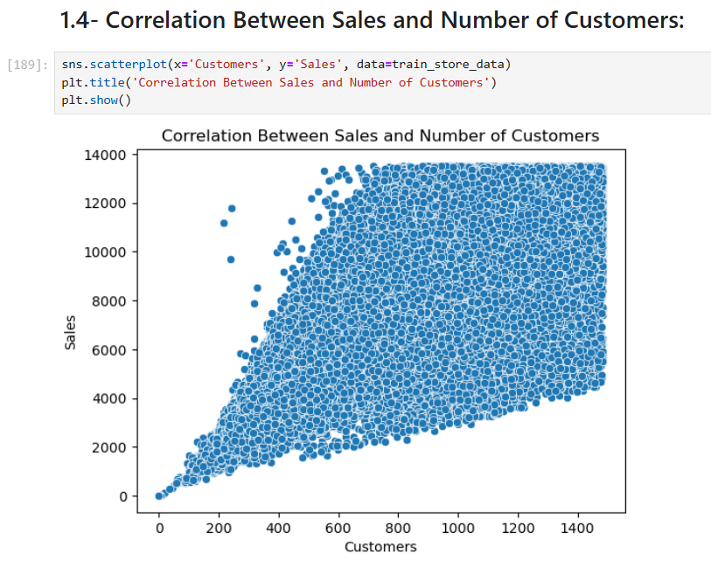
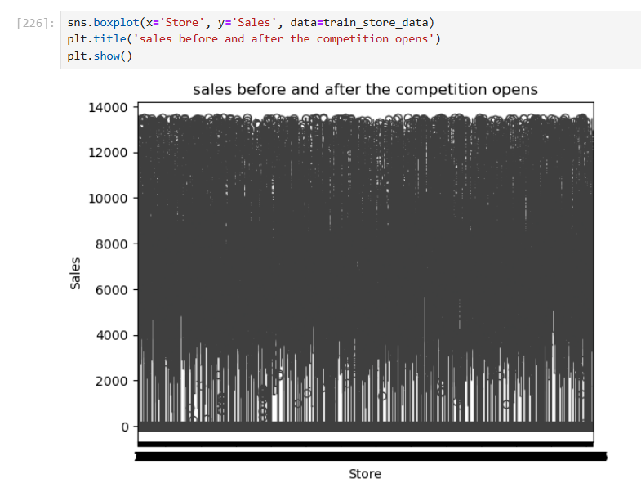
EDA Visualizations
🧩 Key Plots & Visuals
Promo Distribution – Train vs Test
Bar chart or KDE plot comparing promotion presence
Sales Around Holidays
Line or boxplot showing before, during, and after holiday periods
Seasonal Patterns
Time series plot highlighting spikes around Christmas, Easter, etc.
Correlation Scatterplot
Highlight strong relationship:
Sales ↔ Customers
Competition Effect
Highlight strong relationship:
Old Vs New Competitors

Slide 6
Store Behavior Analysis
🕒 Store Operating Patterns
Stores open all weekdays tend to show higher weekend sales, suggesting momentum from weekday traffic.
🛍️ Promo2 Effectiveness
Promo2 campaigns are more effective in urban or high-traffic areas, especially where competition is low.
📍 Competitor Distance
Stores with closer competitors experience reduced sales, especially when competition is within 500 meters.
🧺 Assortment Impact
Stores with Assortment Type C consistently record the highest average sales, indicating customer preference for wide product variety.

Slide 7
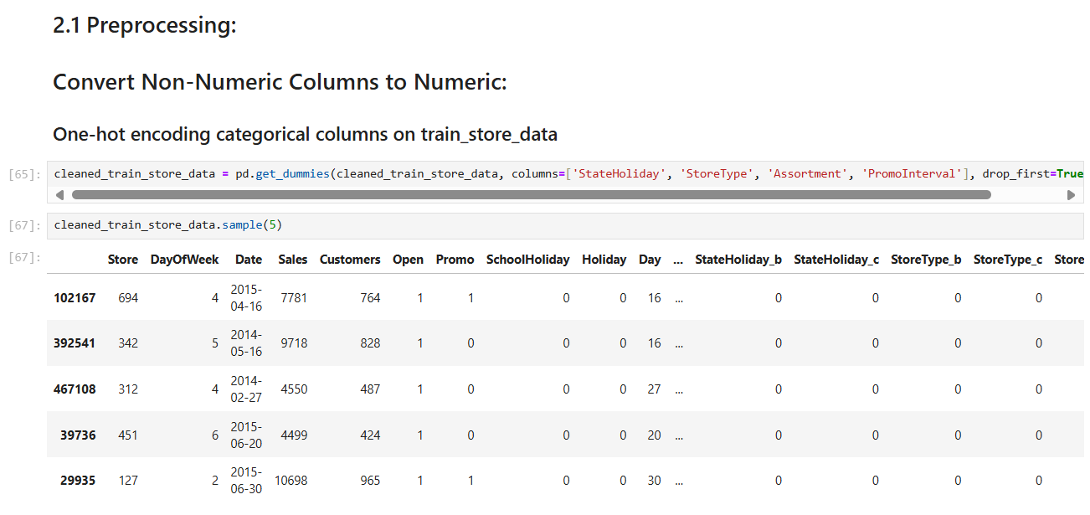
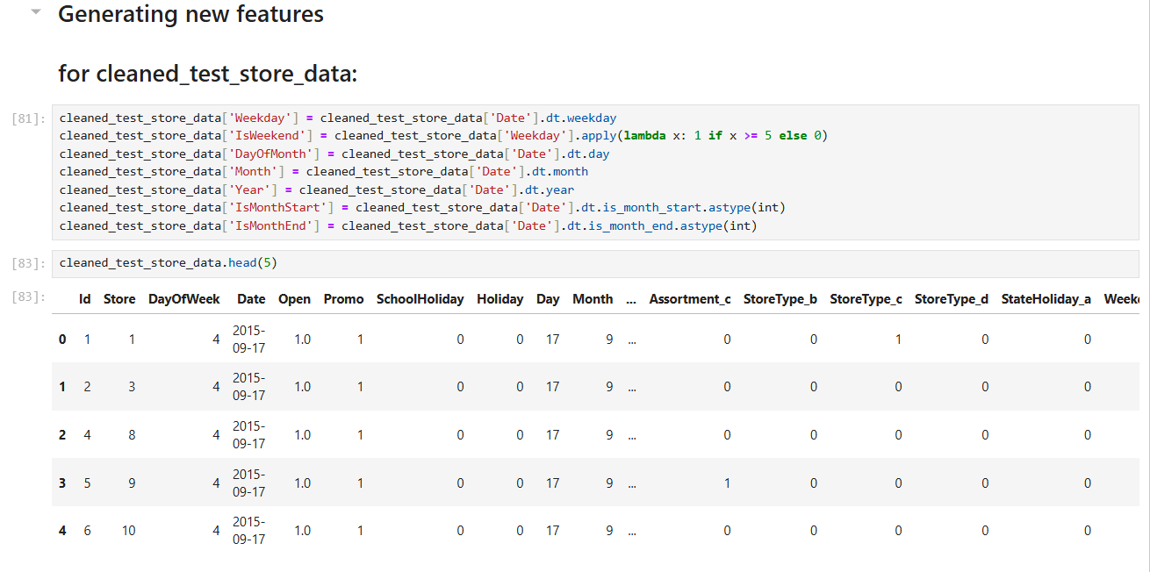
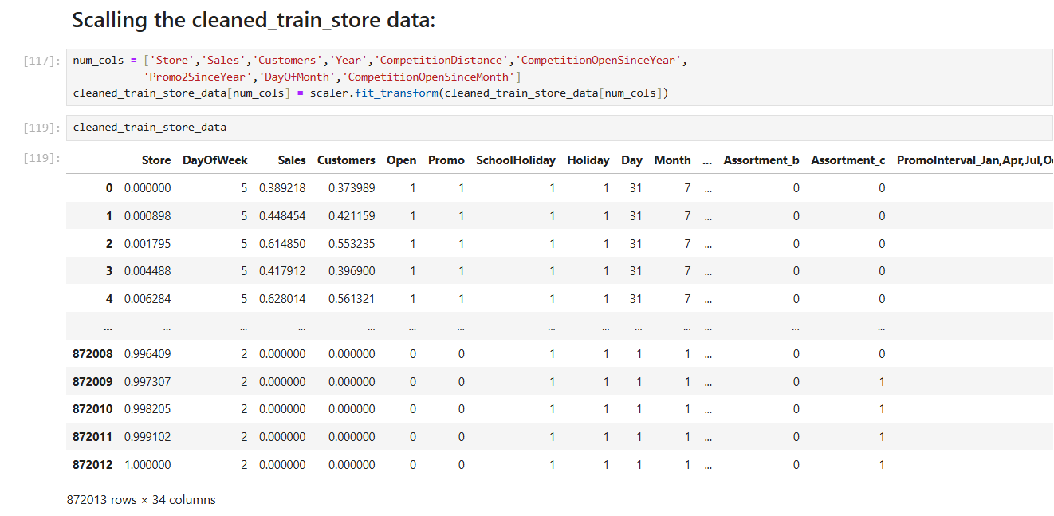
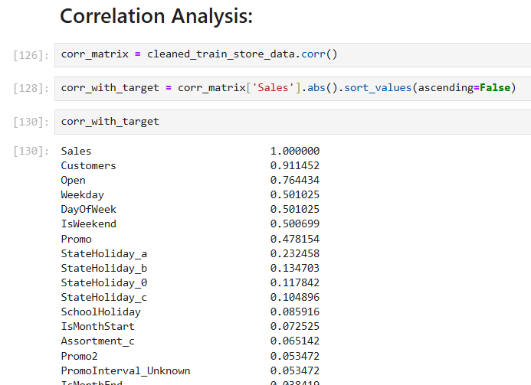
🧠 Feature Engineering
Extracted time-based features:
Weekday / Weekend
Start/Mid/End of Month
Days Before & After Holidays
🔢 Numerical Transformation
Converted all categorical columns to numeric
Handled missing values (NaNs) using imputation or removal based on context
📏 Feature Scaling
Applied StandardScaler for normalization
Correlation Analysis
Data Preprocessing

Slide 8
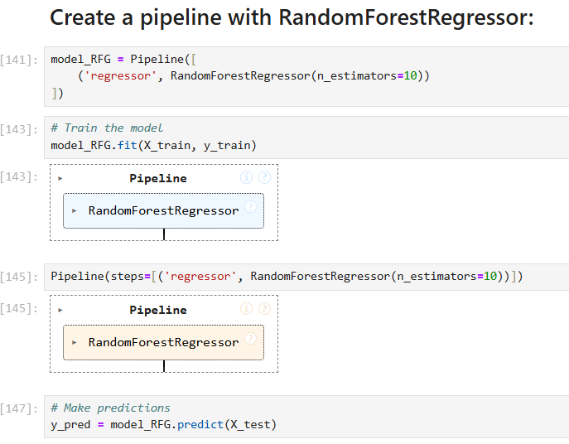
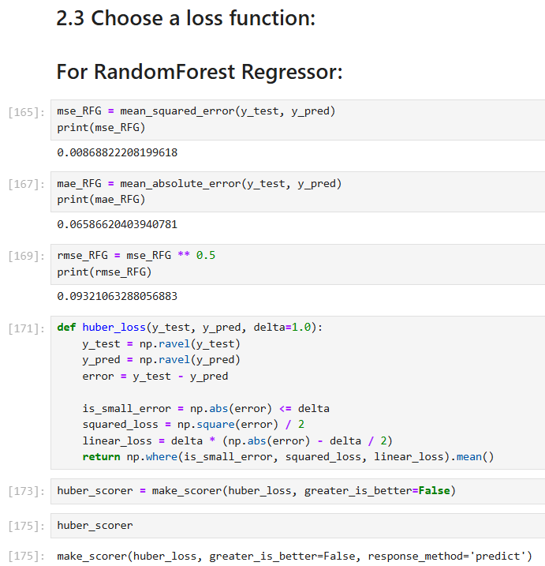
Machine Learning Modeling
🤖 Model Choice
Selected: RandomForestRegressor using Sklearn Pipeline
📉 Loss Function
Used Root Mean Squared Error (RMSE) for evaluation
Reason: Penalizes large errors and is easy to interpret
📊 Performance Metrics
RMSE and R² calculated on validation data
Achieved solid performance with low error and decent variance explained
📌 Feature Importance
Top features: Customers, Promo, DayOfWeek, Month, CompetitionDistance

Slide 9
Model Serialization & Logging
🗃️ Model Serialization
Saved models using timestamped filenames
Example: model-14-08-2025-12-51-51-413239.pkl
🧰 Tools
Used joblib and pickle for efficient storage and loading
Ensures compatibility during deployment
📑 Version Control
Maintained daily versions of models for traceability
Useful for monitoring model drift or retraining history
📝 Logging
Implemented Python logger to track:
Data cleaning steps
Preprocessing stages
Model training and serialization
🧪 Model → 📊 Evaluate → 📝 Log → 💾 Save → 🚀 Deploy

Slide 10
LSTM Time Series Modeling
🔍 Time Series Preparation
Stationarity Check using ADF Test
Applied differencing to remove trends
Used autocorrelation (ACF) and partial autocorrelation (PACF) plots to understand lag relationships
🔄 Supervised Learning Setup
Implemented Sliding Window technique
Transformed time series into (X, y) format
🧠 Model Architecture
Built 2-layer LSTM model (lightweight)
Scaled input data to (-1, 1) using MinMaxScaler
⚙️ Framework
Developed and trained using TensorFlow/Keras
Executed in Google Colab for efficiency

Slide 11
MLflow Inference
📦 Model Tracking
Integrated MLflow for end-to-end tracking
Version-controlled each serialized model with timestamp
📊 Metrics Logged
Tracked key metrics:
Loss
RMSE
⚙️ Inference API
Used MLflow's model serving API
Enabled quick test-time predictions
🔁 Benefits
Compare multiple models easily
Rollback to older models if needed
Helps in A/B testing and performance monitoring
[ Train Model ] ➜ [ Log Metrics ] ➜ [ Serialize with Timestamp ] ➜ [ Register Model ] ➜ [ Serve Predictions ]

Slide 12
Web App Deployment
Framework: Streamlit
📥 User Input Features
Store ID selection
CSV upload with:
Date, IsPromo, IsHoliday, IsWeekend, etc.
📈 Output
Predicted Sales & Customer Count
Interactive Line Chart of forecasts

Slide 13
Conclusion
✅ Project Achievements
✅ Performed comprehensive exploratory data analysis to uncover key sales drivers (promo, holidays, assortment, etc.)
✅ Built robust machine learning models (Random Forest) using Sklearn pipelines
✅ Developed a deep learning LSTM model for time series forecasting
✅ Deployed a Streamlit-based interactive web app for real-time sales prediction
✅ Used MLflow for model tracking, logging, and versioning

Slide 14
Reference
Documentation & Libraries
Pandas: https://pandas.pydata.org/docs/
Matplotlib: https://matplotlib.org/stable/index.html
Seaborn: https://seaborn.pydata.org/
Scikit-learn: https://scikit-learn.org/stable/
TensorFlow (LSTM): https://www.tensorflow.org/api_docs
MLflow: https://mlflow.org/docs/latest/index.html
Streamlit: https://docs.streamlit.io/
Tools & Platforms
Google Colab (for training): https://colab.research.google.com
Kaggle Notebooks: https://www.kaggle.com/code
MLflow Setup: https://mlflow.org/docs/latest/quickstart.html
Streamlit Deployment: https://docs.streamlit.io/streamlit-cloud

Slide 15
THANK YOU!

